Slide 1

ECE 281 Lesson 10
Maj Jeffrey Falkinburg USAFA/DFEC
Room 2E46E 333-9193
1

Slide 2
Lesson 10 Outline
Do Time Logs!
Adders
Half Adder
Full Adder
Carry Propagate
Subtractors
Comparators
Equality
Magnitude
If time permits War Story Monday (SIDFOT)
Due Now! - Lab 1 Lab Notebook Due COB

Slide 3
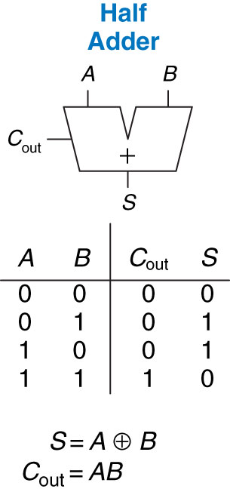
Half Adder
Figure 5.1 1-bit half adder
Copyright © 2013 Elsevier Inc. All rights reserved.

Slide 4
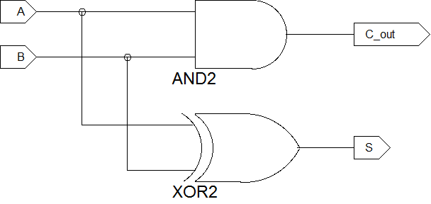
Half Adder - Schematic

Slide 5
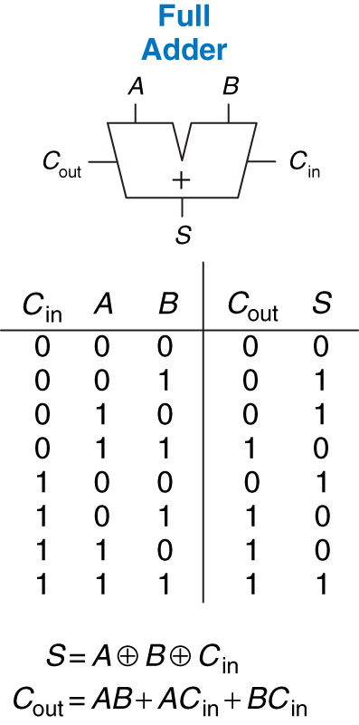
Full Adder
Figure 5.3 1-bit full adder
Copyright © 2013 Elsevier Inc. All rights reserved.

Slide 6
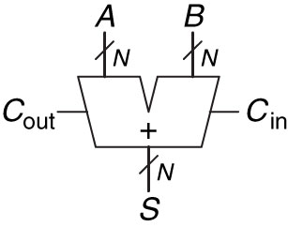
Carry Propagate Adder
Figure 5.4 Carry propagate adder
Copyright © 2013 Elsevier Inc. All rights reserved.

Slide 7
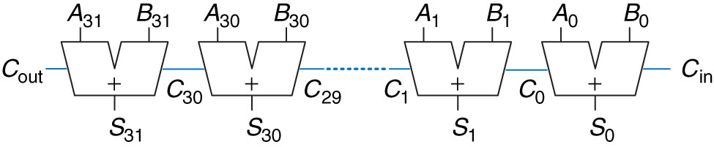
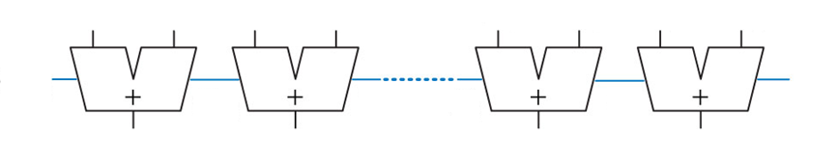
Ripple-Carry Adder
Figure 5.5 32-bit ripple-carry adder

Slide 8
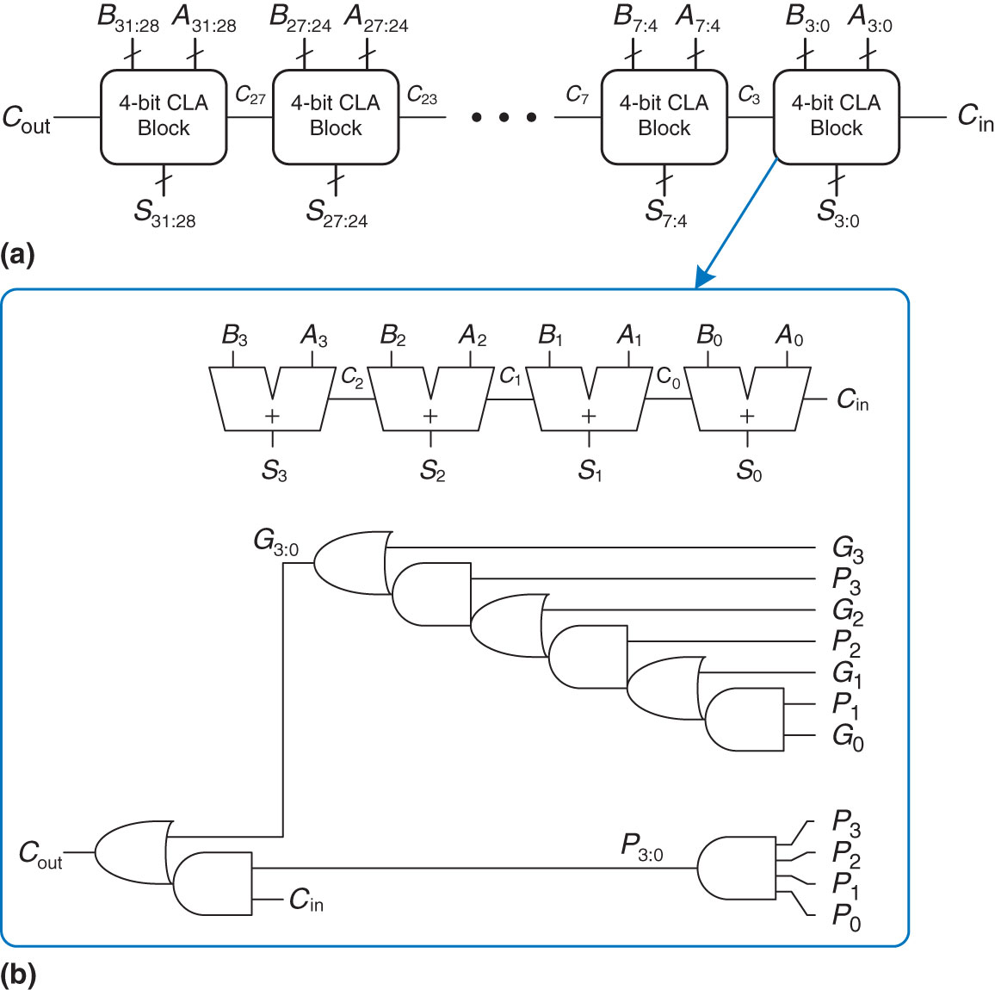
Carry-Lookahead Adder
Figure 5.6 (a) 32-bit carry-lookahead adder (CLA), (b) 4-bit CLA block
Copyright © 2013 Elsevier Inc. All rights reserved.

Slide 9
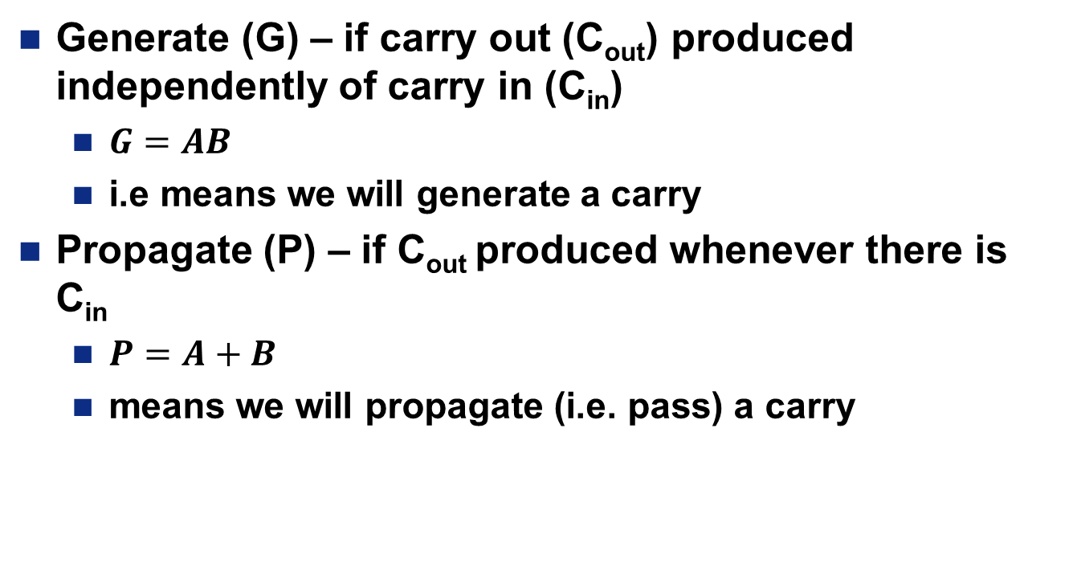
Generate vs Propagate Carry
Generate (G) – if carry out (C_{out}) produced independently of carry in (C_{in})
$G=AB$
i.e means we will generate a carry
Propagate (P) – if C_{out} produced whenever there is C_{in}
$P=A+B$
means we will propagate (i.e. pass) a carry

Slide 10
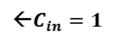
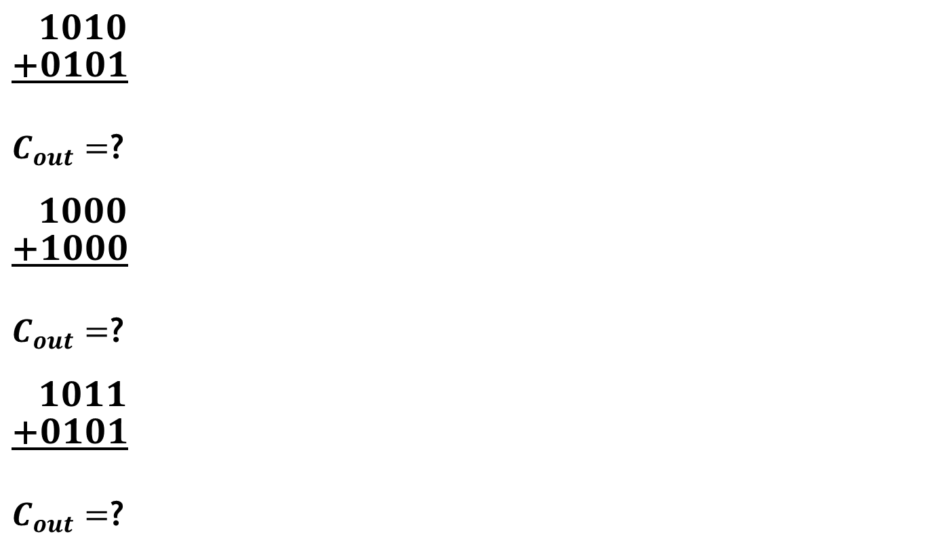
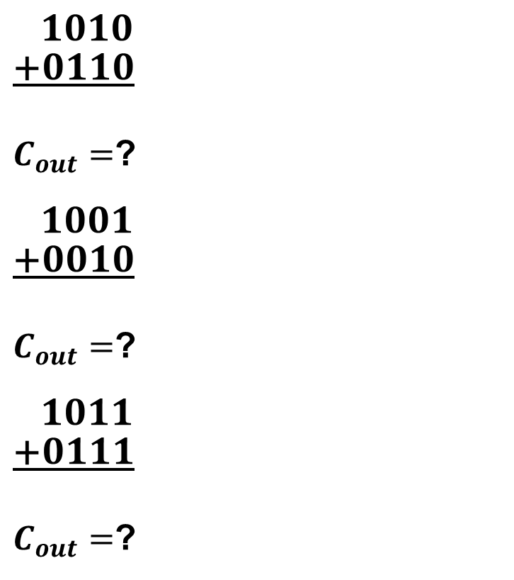
Examples
$\frac{\begin{aligned} 1010 \\ +0101\end{aligned}}{ }$
$C_{out}=$?
$\frac{\begin{aligned} 1000 \\ +1000\end{aligned}}{ }$
$C_{out}=$?
$\frac{\begin{aligned} 1011 \\ +0101\end{aligned}}{ }$
$C_{out}=$?
$\frac{\begin{aligned} 1010 \\ +0110\end{aligned}}{ }$
$C_{out}=$?
$\frac{\begin{aligned} 1001 \\ +0010\end{aligned}}{ }$
$C_{out}=$?
$\frac{\begin{aligned} 1011 \\ +0111\end{aligned}}{ }$
$C_{out}=$?
←$C_{in}=1$
←$C_{in}=1$

Slide 11
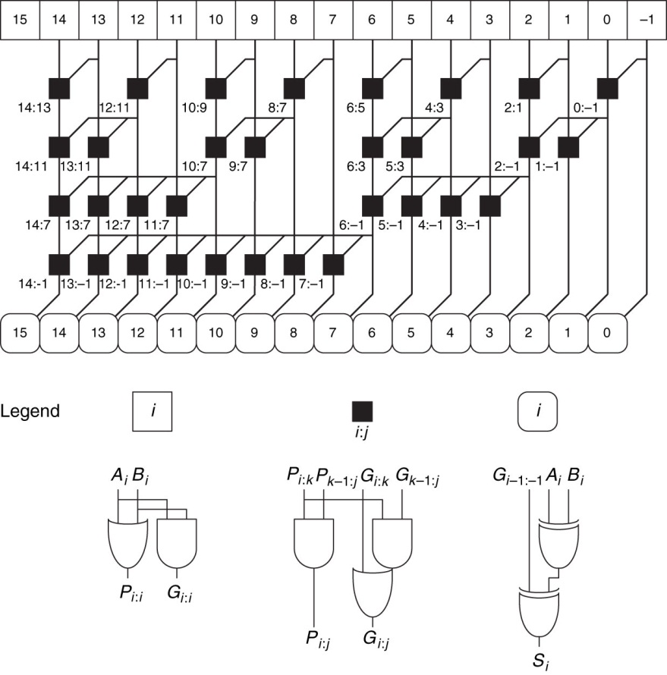
16-Bit Prefix Adder
Figure 5.7 16-bit prefix adder
Copyright © 2013 Elsevier Inc. All rights reserved.

Slide 12
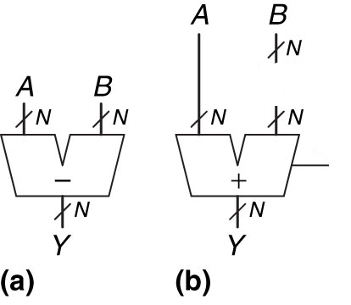
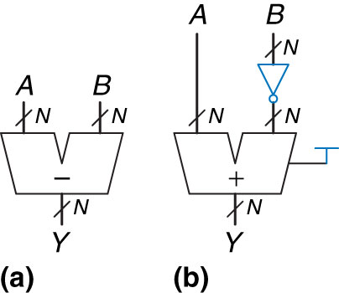
Subtractor
How do we subtract?
Figure 5.9 Subtractor: (a) symbol, (b) implementation
Copyright © 2013 Elsevier Inc. All rights reserved.

Slide 13
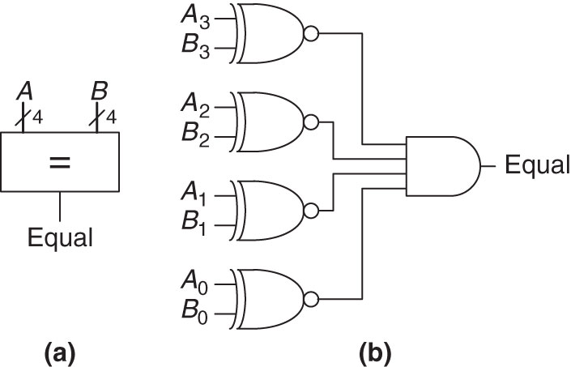
Equality Comparator
XNOR
A | B | Y
0 | 0
0 | 1
1 | 0
1 | 1
Figure 5.11 4-bit equality comparator: (a) symbol, (b) implementation
Copyright © 2013 Elsevier Inc. All rights reserved.

Slide 14
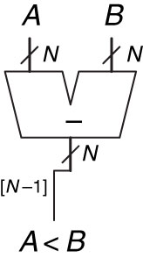
Magnitude Comparator
Figure 5.12 N-bit magnitude comparator
Copyright © 2013 Elsevier Inc. All rights reserved.

Slide 15
N-Bit Comparator
Draw an N-Bit Comparator Entity
Why are Comparators useful?
Figure 5.12 N-bit magnitude comparator
Copyright © 2013 Elsevier Inc. All rights reserved.

Slide 16
Implementation
Implement this function using things we learned today?
No Gates..Just Logic Functions
If a < 4
z = y + 3
else
z = y + 7

Slide 17


Slide 18
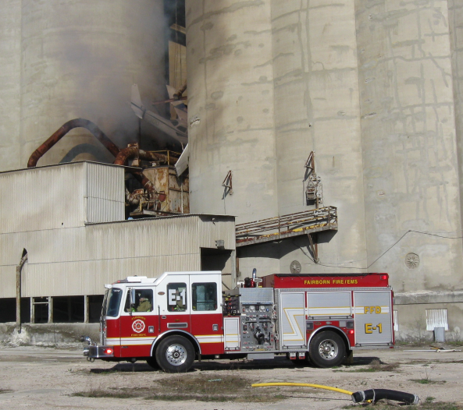
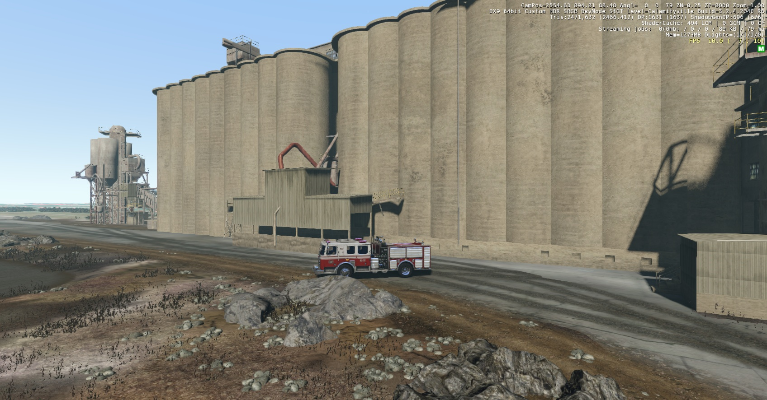
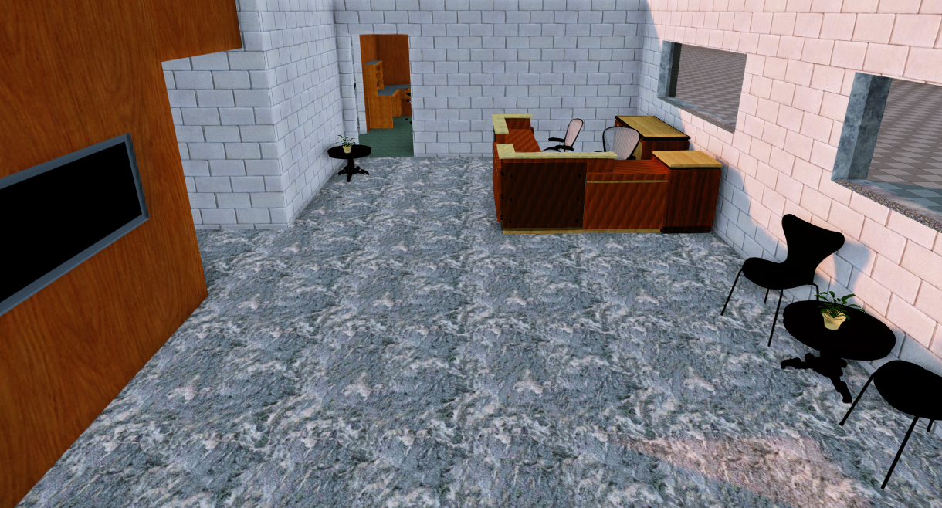
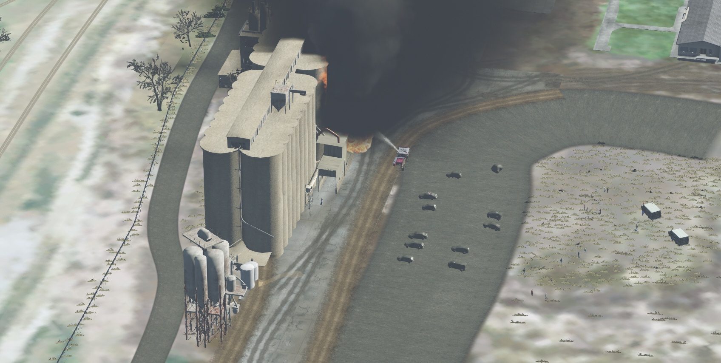
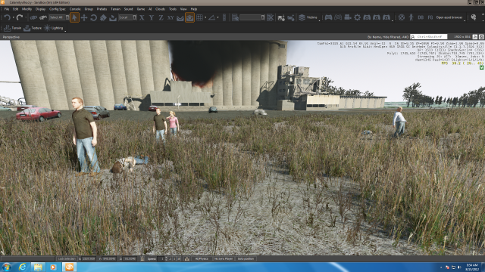

Slide 19
Extra Instruction (EI)
Maj Jeffrey Falkinburg
2E46E
Office: 333-9193
M1
ECE 281 – 2F44
T1
M2
ECE 281 – 2F44
T2
M3
ECE 463 – 2G2
T3
ECE 383 – 2E48A
M4
ECE 463 – 2G2
T4
ECE 383 – 2E48A
Available
M5
T5
Sometimes Available
M6
ECE 383 – 2E48A
T6
Always Unavailable
M7
ECE 383 – 2E48A
T7

Slide 20

20

